Slide 1
Recent Trends in Supercomputing Architecture

Slide 2
Outline
HPC Global scenario
Recent Trends in HPC
HPC at C-DAC

Slide 3
HPC Global Scenario

Slide 4
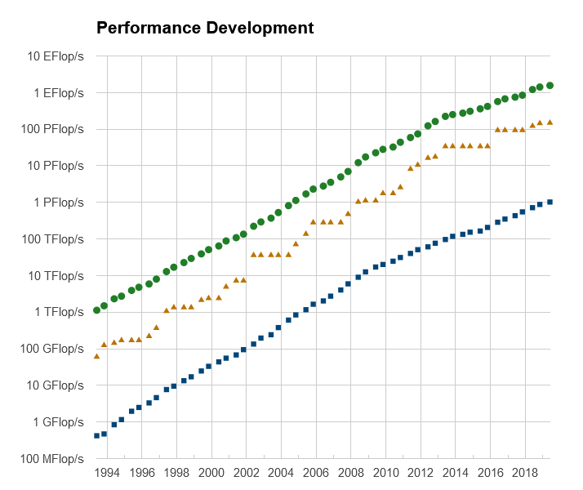
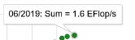
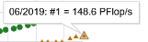
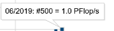
Source: Top500.org

Slide 5
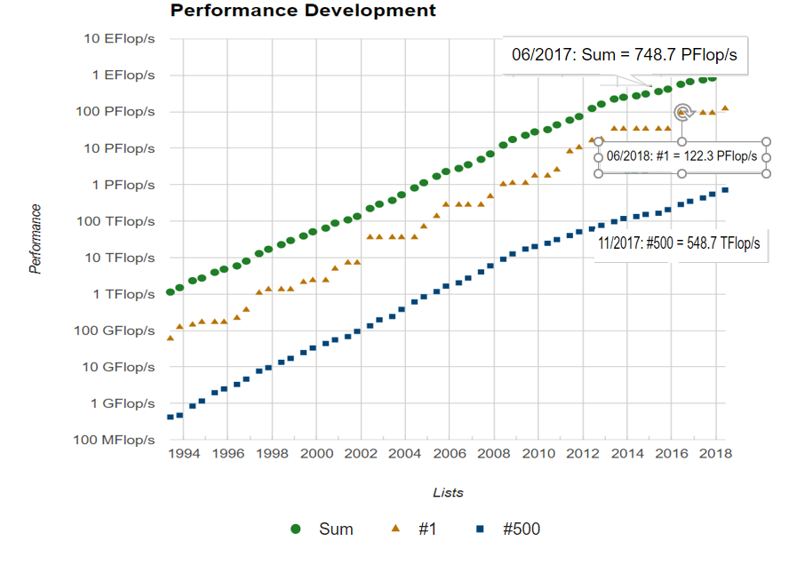

Slide 6
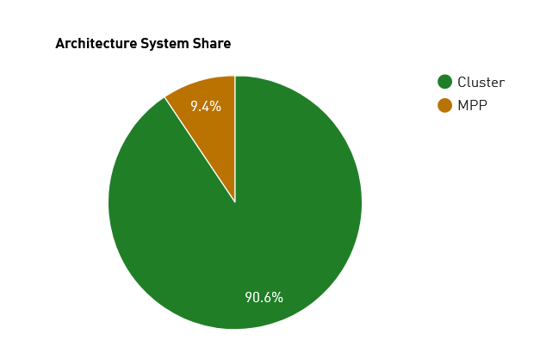
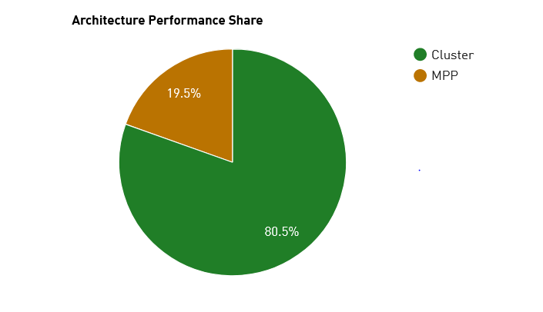
Architecture
Source: Top500.org
Notes:
MPP-Massively Parallel Processing : large number of processors (or separate computers) to perform a set of coordinated computations in parallel
If there are more microprocessors in a node than there are nodes in the commodity cluster, then the dominant mode of parallelism is at the second level and this is referred to as a “constellation”
*
6

Slide 7
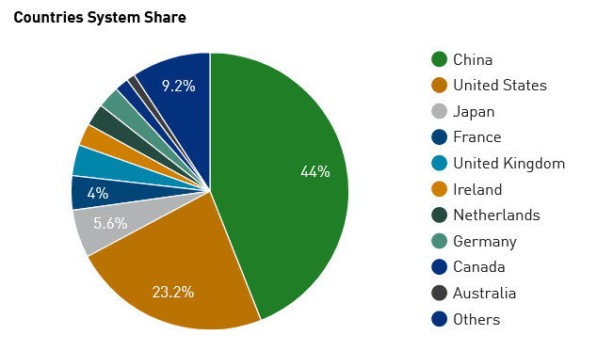
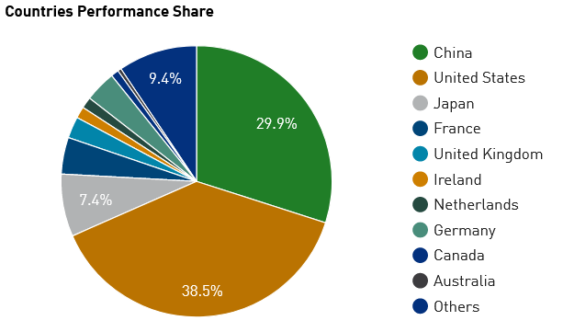
Countries share
Source: Top500.org

Slide 8
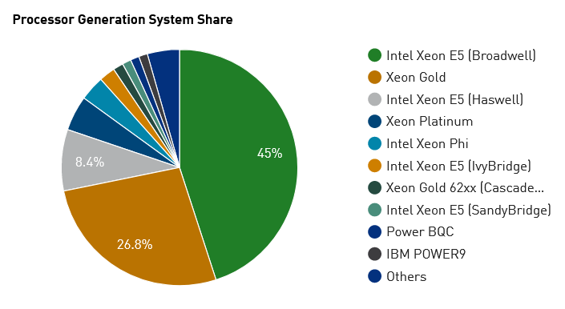
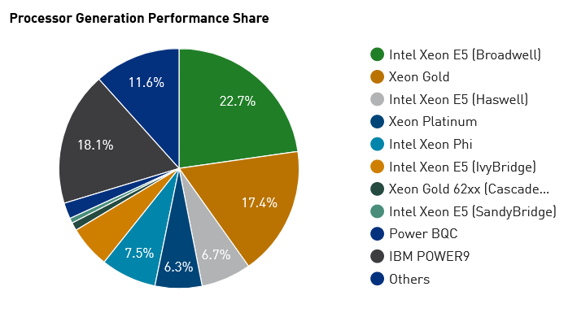
Processor Family / Systems
Source: Top500.org

Slide 9
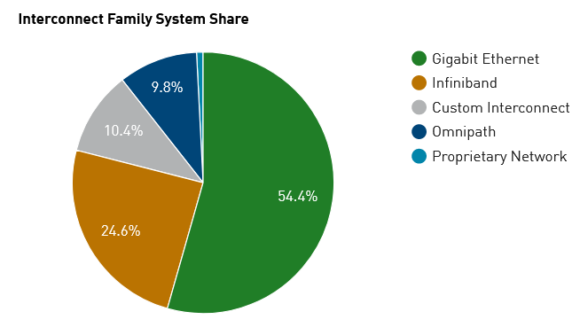
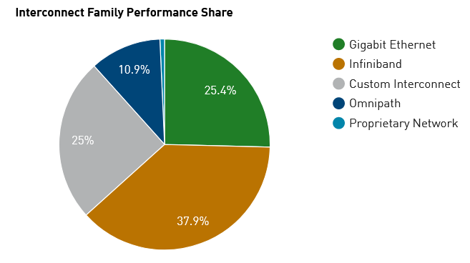
Interconnect Family / Systems
Source: Top500.org

Slide 10
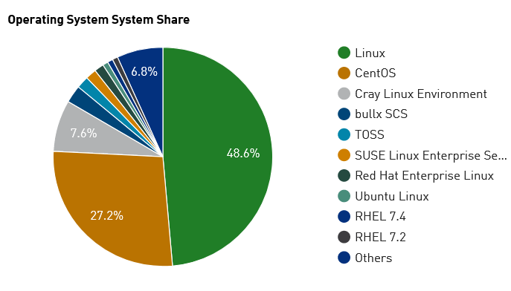
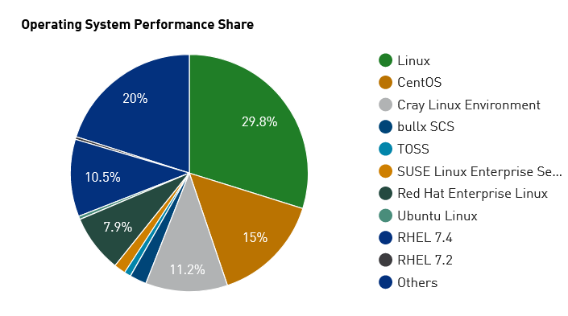
Operating Systems Family
Source: Top500.org

Slide 11
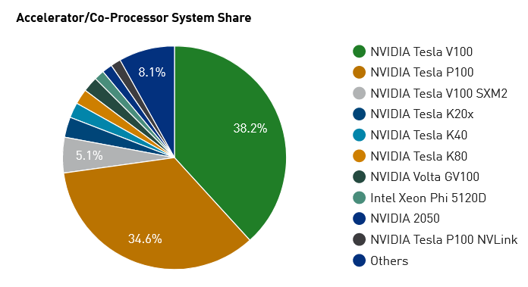
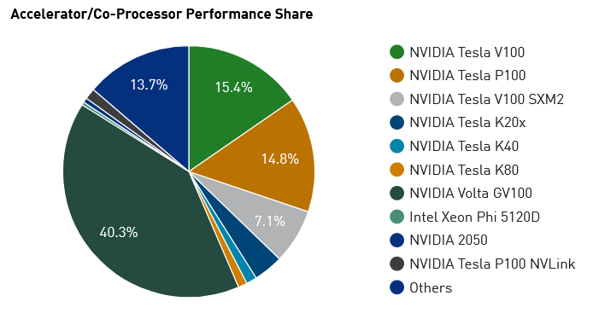
Accelerator/Co-Processor Family
Source: Top500.org

Slide 12
Recent Trends In HPC

Slide 13
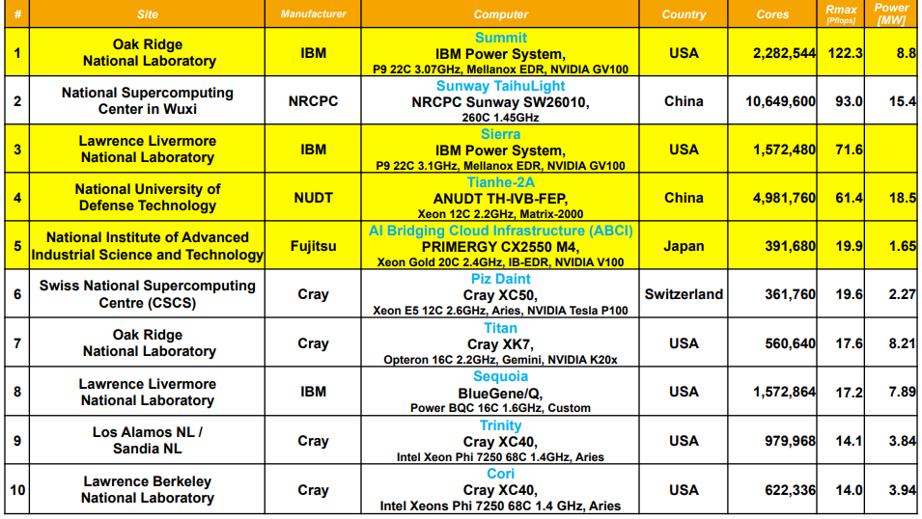
Top10 (June 2019)
Notes:
A system's Rmax score describes its maximal achieved performance; the Rpeak score describes its theoretical peak performance. Values for both scores are usually represented in teraFLOPS or petaFLOPS
*
13

Slide 14
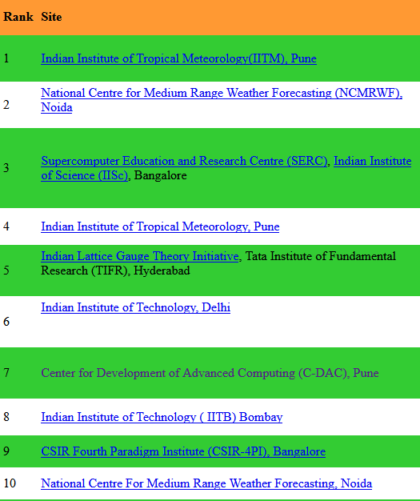
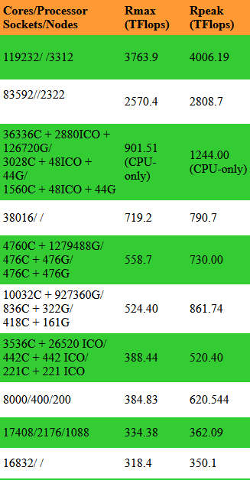
Top 10 Supercomputers in India

Slide 15
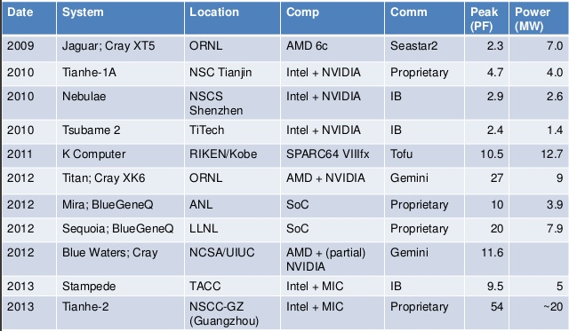
Architecture Trends across recent years
Source: Top500.org

Slide 16
Importance of Muticore and ManyCore Architecture

Slide 17
Sea Change in Chip Design Today
Moore’s law has hit the wall!
Reduced to 20% improvement of Processor Performance per year from 2002(earlier 52%).
Brick Wall = (Heat Wall + ILP Wall + Memory Wall)
Maximum Power Dissipation of Air-Cooled Chips reached its limits
~ 130 Watts
Little Instruction Level Parallelism (ILP) left to exploit efficiently.
Memory wall has been hit, unchanged memory latency
2, 4, 8, 16 Cores/Chip are Common.
100 Cores chip have already been announced!
Thousands of cores chips already at Drawing Board Level!

Slide 18
Multicore & ManyCore
Processor
0
1
0
1
0
1
2
3
0
1
2
3
4
5
6
7
2
3
4
5
6
7
8
9
10
11
12
13
14
15
Single core CPU
Dual core CPU
Quad core CPU
Eight core CPU
Sixteen core CPU
Many Core
Notes:
Multicore: optimized processor cores
Many cores: simplified cores (not fully optimized cores)
*
18

Slide 19
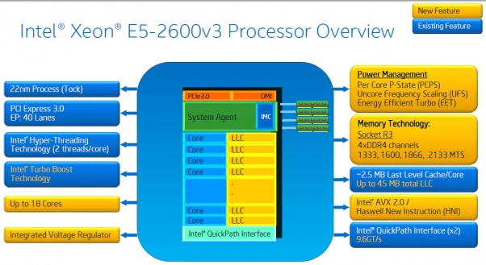
Haswell
Notes:
*
19

Slide 20
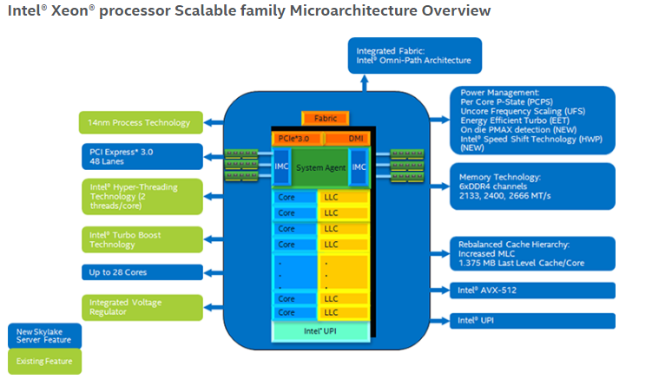
Skylake
Notes:
*
20

Slide 21
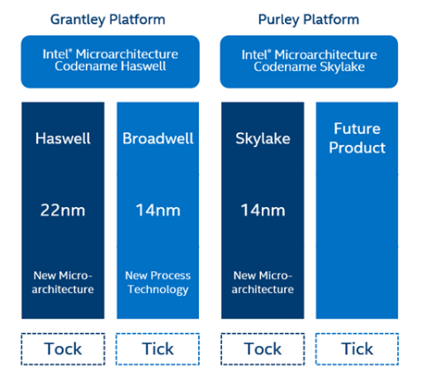
Notes:
*
21

Slide 22
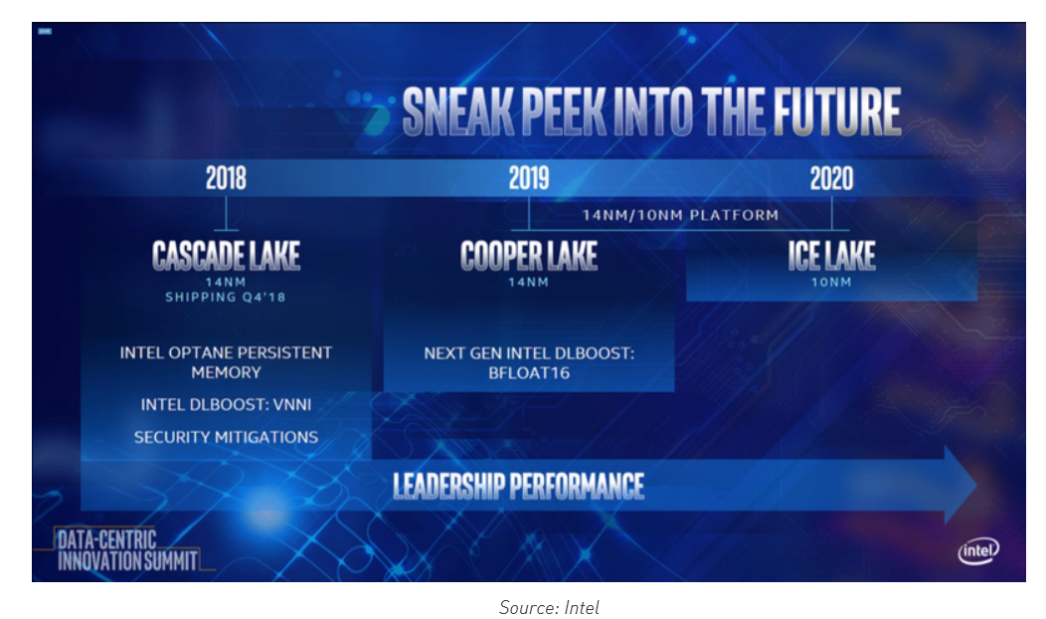
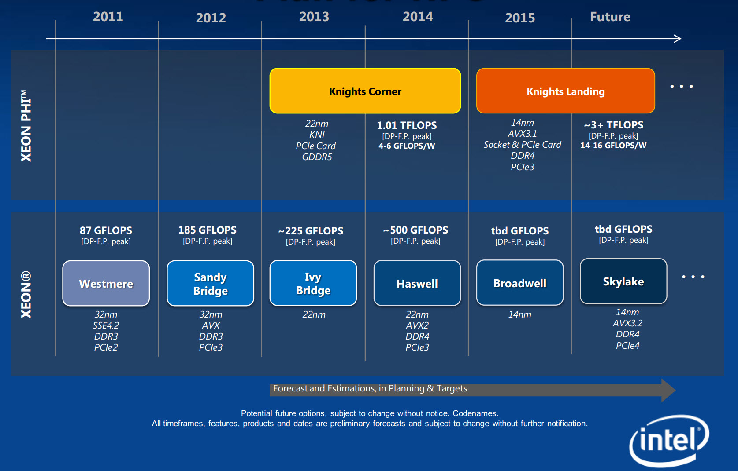
Intel Xeon Processor Roadmap Plan for HPC
Notes:
With every "tick" cycle, look for Intel to advance manufacturing process technology and continue to deliver the expected benefits of Moore’s Law to users.
In alternating “tock” cycles, expect Intel to use the previous “tick” cycle’s manufacturing process technologies to introduce the next big innovation in processor microarchitecture
*
22

Slide 23
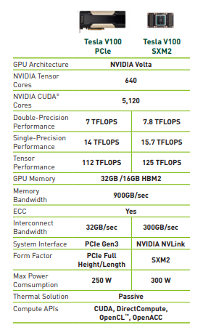
GPU

Slide 24
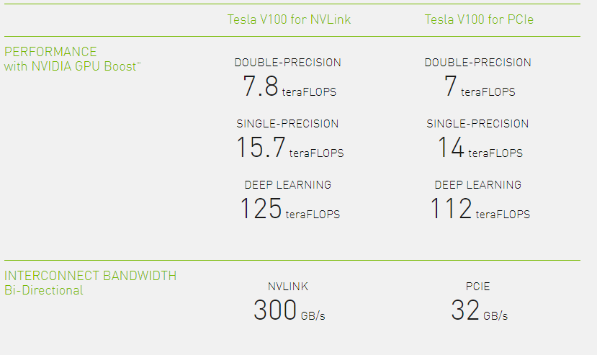
GPU

Slide 25
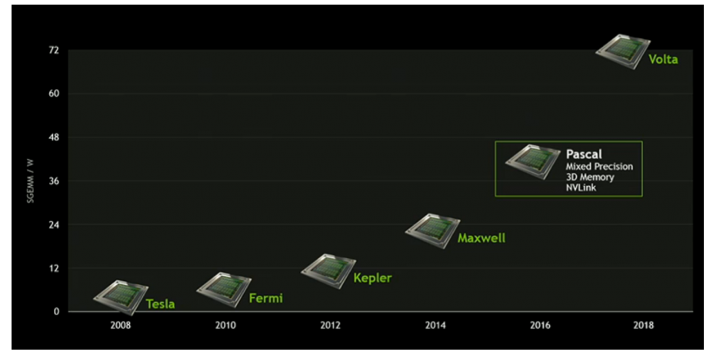

GPU Roadmap

Slide 26
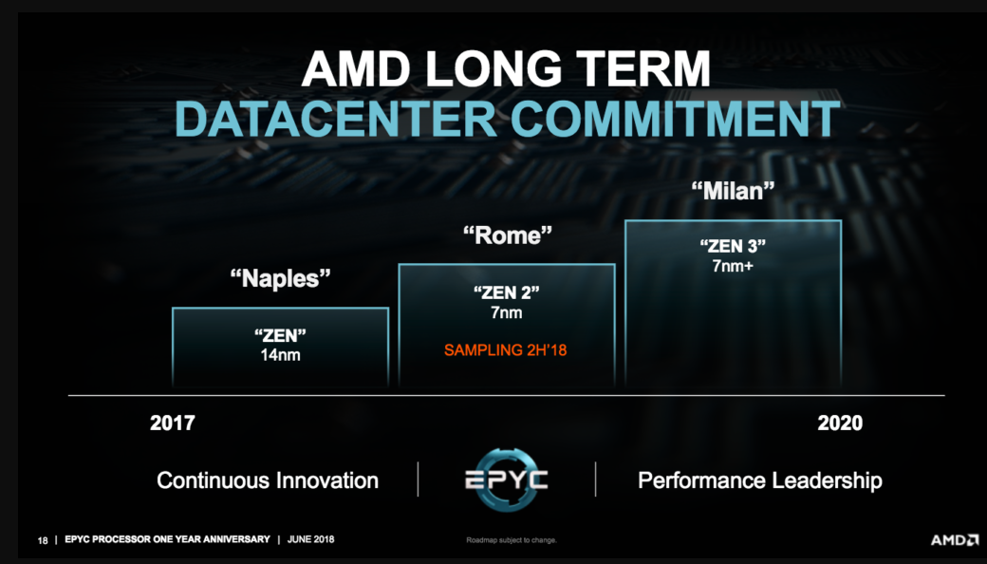

Slide 27
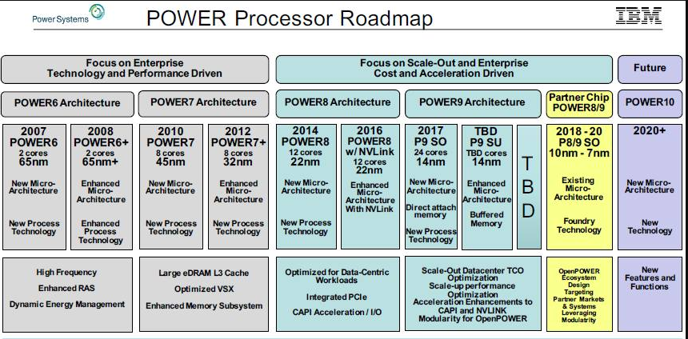

Slide 28
HPC @ C-DAC

Slide 29
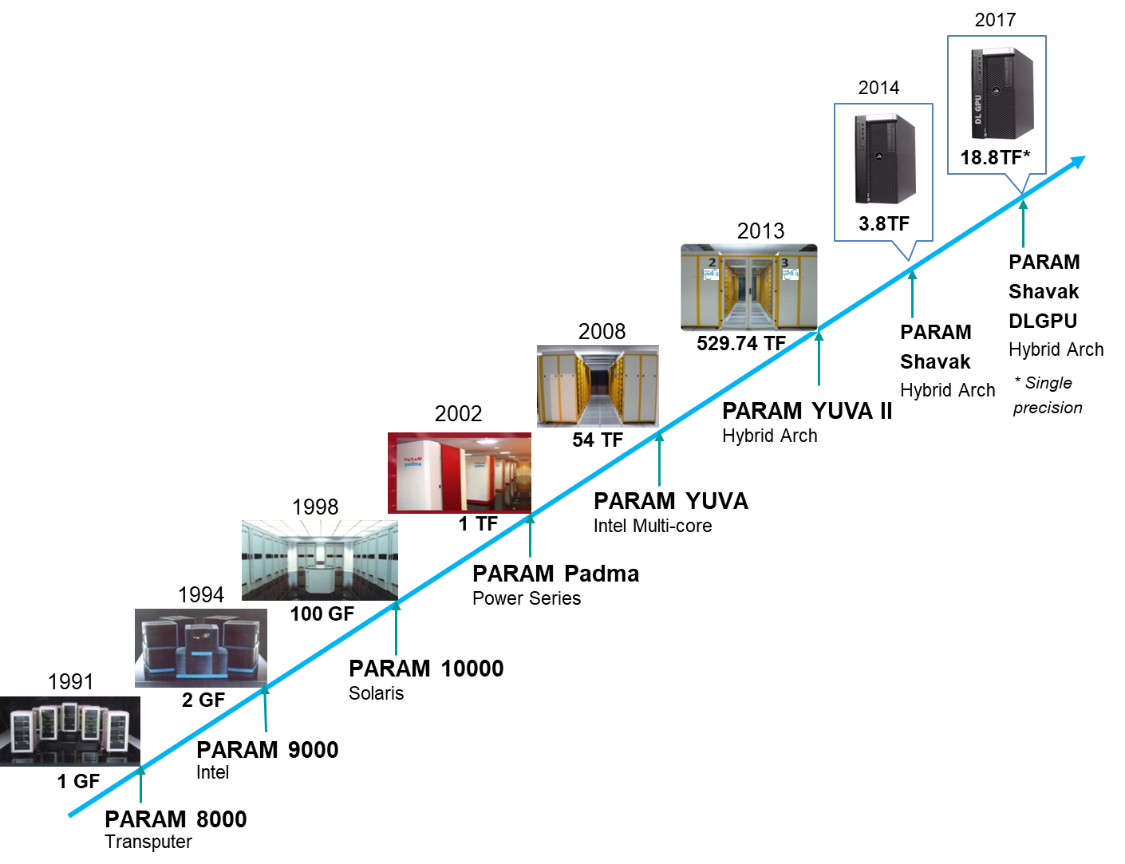

C-DAC’s PARAM Series of Supercomputers

Slide 30
About PARAM Yuva-II
Enhanced version of PARAM Yuva
Hybrid computing using Intel Xeon Phi accelerators
524TF peak, 388.4 TF sustained performance
#172 Rank in TOP500 list (Jun’15),#131 Rank in (Nov’14), #69 (Jun’13)
Excels in power efficiency, #88 Rank in Green 500 (Jun’15) and first rank in India
Housed at National Param Supercomputing Facility (NPSF), at CDAC, Pune

Slide 31
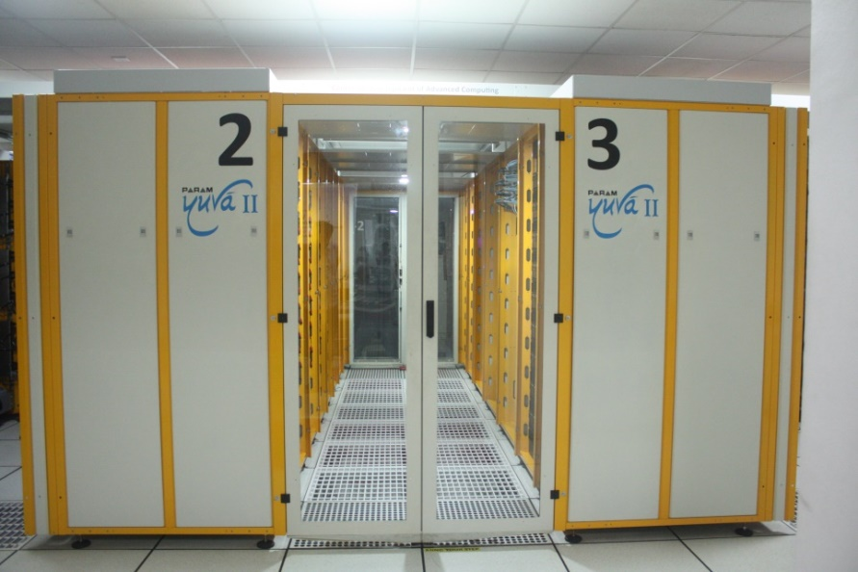
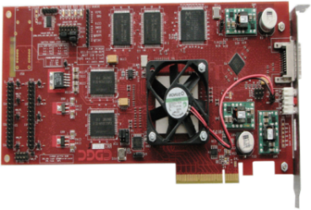
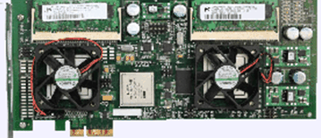
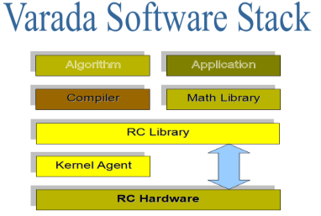
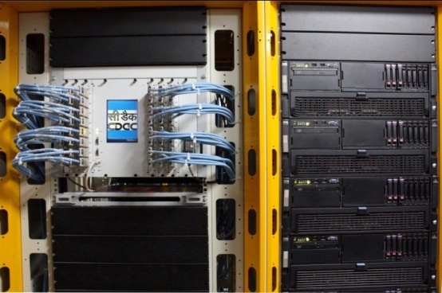
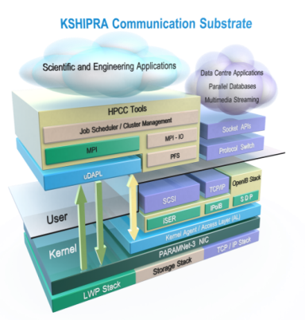
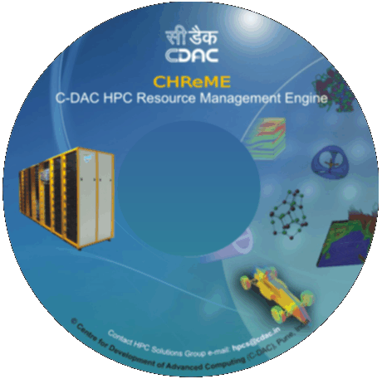
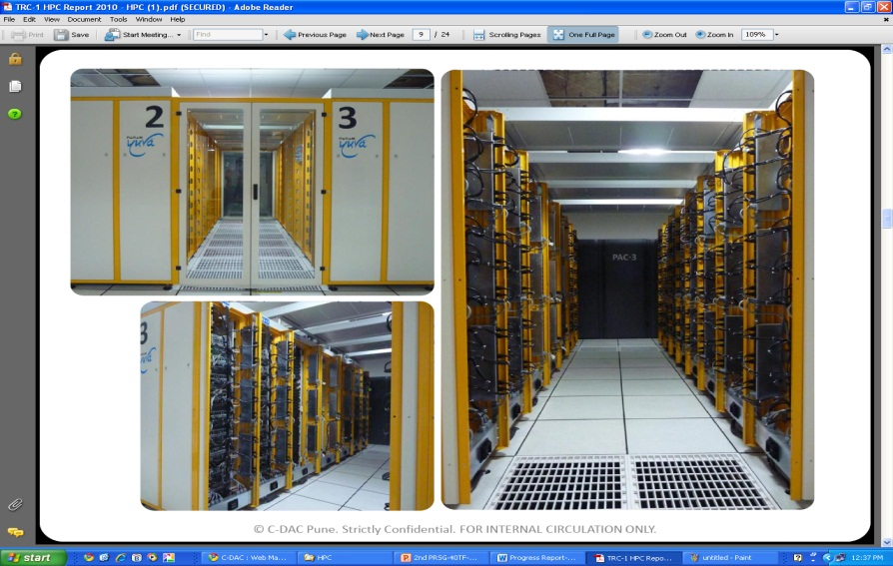
Indigenous Components in PARAM
PARAMNet-3 Card
RC Accelerator
Switch
PARAM Yuva II
Varada Software Stack
Industrial
Design
KSHIPRA Communication Substrate
System & Application Software
Notes:
Smith waterman –bio informatics , for sequence alignment
PARAM net 3= 10Gpbs
PARAM net 2 = 2.5 Gpbs
*
31

Slide 32
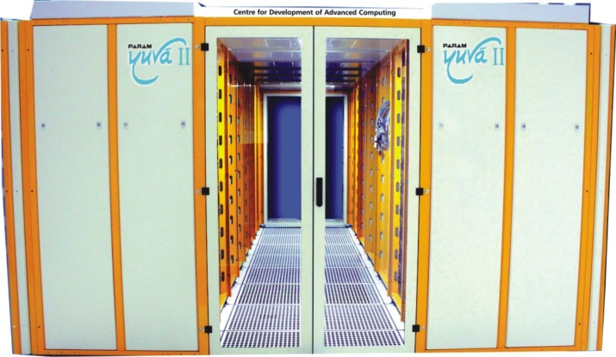
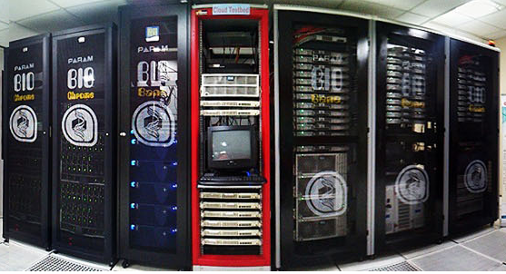
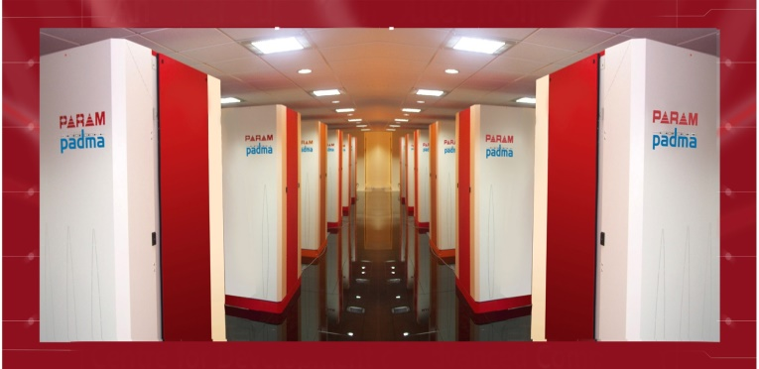
National HPC Facilities
NPSF at C-DAC, Pune
BRAF at C-DAC, Pune
CTSF at C-DAC, Bangalore

Slide 33
Thank You

